Slide 1
UNIFIED MENTOR – mACHInE LEARNING Internship Project
Mobilephone pricing using Machine Learning Techniques
Indumathi Rajendran

Slide 2

Agenda introduction dataset overview Exploratory Data Analysis Data Preprocessing Model Selection & evaluation Final Model and Results Deployment Conclusion

Slide 3
introduction
In today’s fast-evolving smartphone market, predicting the price category of a mobile phone based on its features can help manufacturers, retailers, and consumers make informed decisions. This project aims to build a machine learning model that classifies mobile phones into one of four price ranges — Low, Medium, High, or Very High — using various specifications such as battery power, RAM, camera quality, and connectivity features. By analyzing the data and training classification models, we aim to accurately estimate the price segment of a device before it hits the market.

Slide 4
OBJECTIVE
The objective of this project is to develop a machine learning model that can accurately classify mobile phones into one of four price categories — Low, Medium, High, or Very High — based on their technical specifications. By analyzing market data and identifying key features that influence pricing, the model aims to assist stakeholders in predicting price segments for mobile devices efficiently and reliably.

Slide 5
Dataset overview
The dataset contains information on 2,000 mobile phones, each described by 20 features such as battery power, RAM, internal memory, screen dimensions, camera quality, and support for technologies like 4G, Wi-Fi, and Bluetooth. The target variable, price_range, is a categorical value ranging from 0 to 3, representing four price segments: Low (0), Medium (1), High (2), and Very High (3). The dataset is clean, balanced, and ideal for multi-class classification.
Numerical Features: battery_power, ram, clock_speed, mobile_wt, int_memory, px_height, px_width, etc.
Binary Features: blue, dual_sim, four_g, three_g, touch_screen, wifi
Categorical/Numeric: n_cores (number of processor cores), pc (primary camera), fc (front camera), etc.
The data appears well-structured with no missing values and is suitable for building a multi-class classification model.

Slide 6
Data Preprocessing
Why preprocessing?
Raw data often contains varying scales, noise, or irrelevant patterns. Preprocessing ensures the dataset is clean, standardized, and ready for machine learning models.
Feature Scaling
Many ML algorithms (like SVM, KNN, Logistic Regression) perform better when input features are on a similar scale. StandardScaler was used to normalize the features.
Handling Nulls/Outliers
Although this dataset didn’t have missing values, it’s a standard practice to check and handle them if they exist using imputation or removal techniques.
Encoding (if needed)
For datasets with categorical features, label encoding or one-hot encoding would be required. In this case, all features were numeric or binary.
Target Separation
Splitting the dataset into features (X) and target (y) helps prepare for model training and evaluation.

Slide 7
Exploratory data analysis
To better understand the dataset, we performed exploratory data analysis (EDA) on all features. The data showed a balanced distribution across the four price categories (0 to 3), making it suitable for classification tasks. Key insights include:
RAM and battery power have a strong positive correlation with the price range.
Phones with 4G, 3G, dual SIM, and touch screens are more likely to fall in the higher price categories.
Pixel resolution (px_height × px_width) shows a significant impact on price, indicating that screen quality influences cost.
Outliers and skewed distributions were minimal, and most features were on different scales, requiring normalization.
Visualizations like histograms, box plots, and heatmaps helped in identifying feature importance and patterns within the dataset.

Slide 8
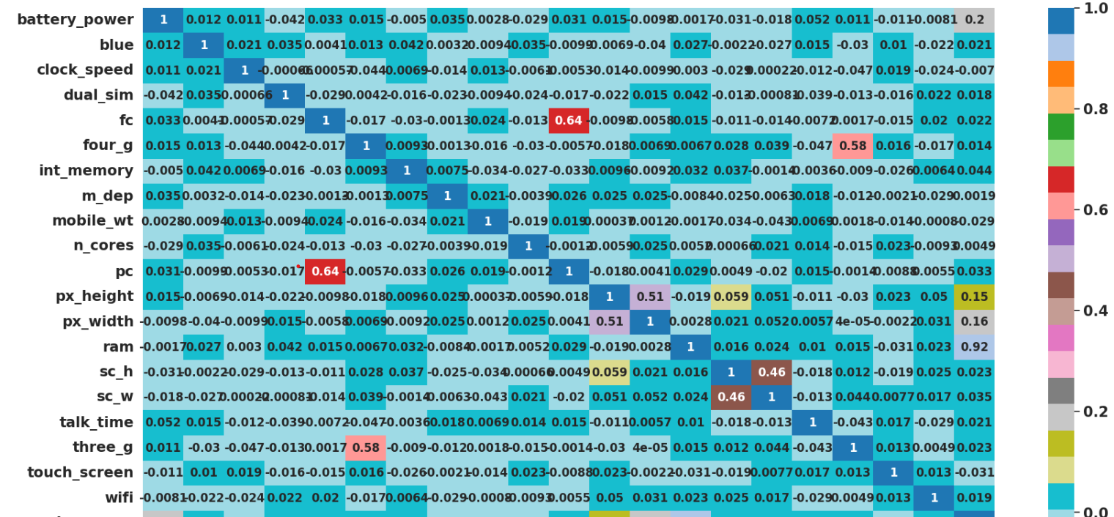
Data visualization – heat map

Slide 9
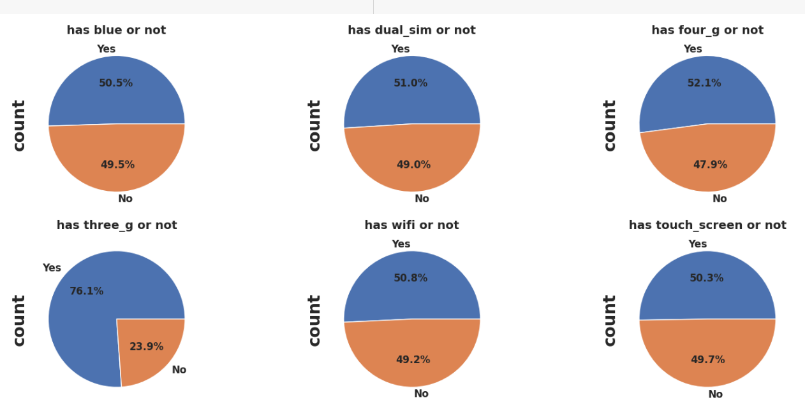
Data visualization – univariate analysis

Slide 10
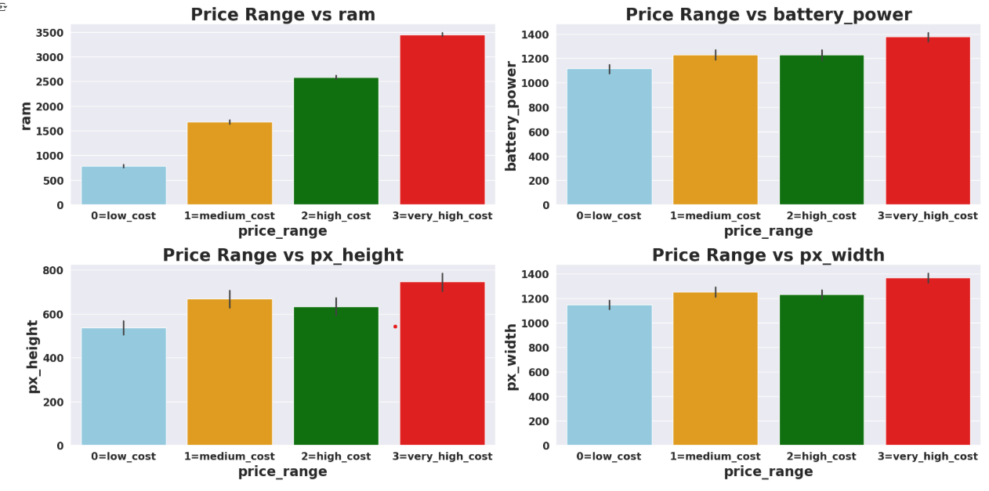
Data visualization – bivariate analysis

Slide 11
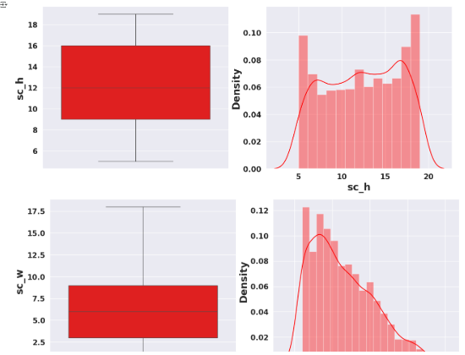
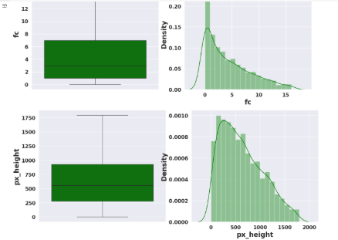
Data Preprocessing- OUTLIER TREATMENT

Slide 12
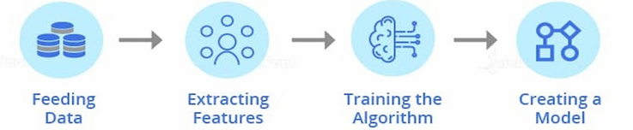
DESIGN METHODOLOGY
The mobile price classification system was built using a structured machine learning workflow. The process began with data loading and exploratory analysis to understand feature relationships and distributions. Preprocessing steps included feature scaling and splitting the dataset into training and testing sets. Multiple classification models such as Logistic Regression, Random Forest, K-Nearest Neighbors, and Gradient Boosting were trained and evaluated using accuracy, confusion matrix, and classification reports. The best-performing model was selected based on overall accuracy and ability to generalize. This modular approach ensured efficient development, testing, and comparison of models for reliable price prediction.

Slide 13


Model selection & evaluation
Data Selection
Multiple classification algorithms were selected to compare performance:
Logistic Regression
Decision Tree
Random Forest
K-Nearest Neighbors (KNN)
Gradient Boosting / XGBoost
Models were chosen based on their suitability for multi-class classification and their interpretability/performance.

Slide 14

Machine Learning Design Approach
1. Dataset Collection & Preprocessing
Collected phishing & legitimate URLs from open-source datasets
Performed Exploratory Data Analysis (EDA)
Cleaned, encoded, and scaled features for model input
2. Model Selection & Development
Split data into training and test sets
Applied ML algorithms: Logistic Regression, KNN, Decision Tree, Random Forest, SVM, AdaBoost, XGBoost
Evaluated using accuracy, precision, recall, F1-score
3. Model Comparison & Optimization
Compared models to find the best performer
Used cross-validation & hyperparameter tuning
Selected final model based on overall performance

Slide 15
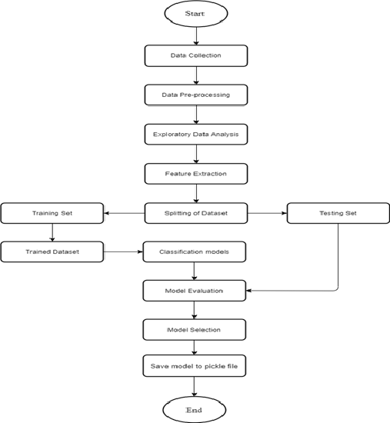

Machine learning Process

Slide 16
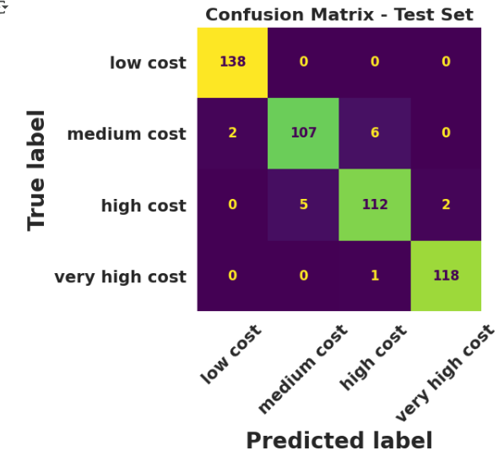
Final model and results
After evaluating multiple classification algorithms, Support Vector Machine (SVM) emerged as the most accurate and consistent model for predicting mobile phone price categories. It achieved the highest overall accuracy on the test set and demonstrated strong performance across all four price classes. The SVM model effectively handled the scaled data and showed minimal overfitting. Based on its precision, recall, and F1-score, it was selected as the final model for deployment.

Slide 17
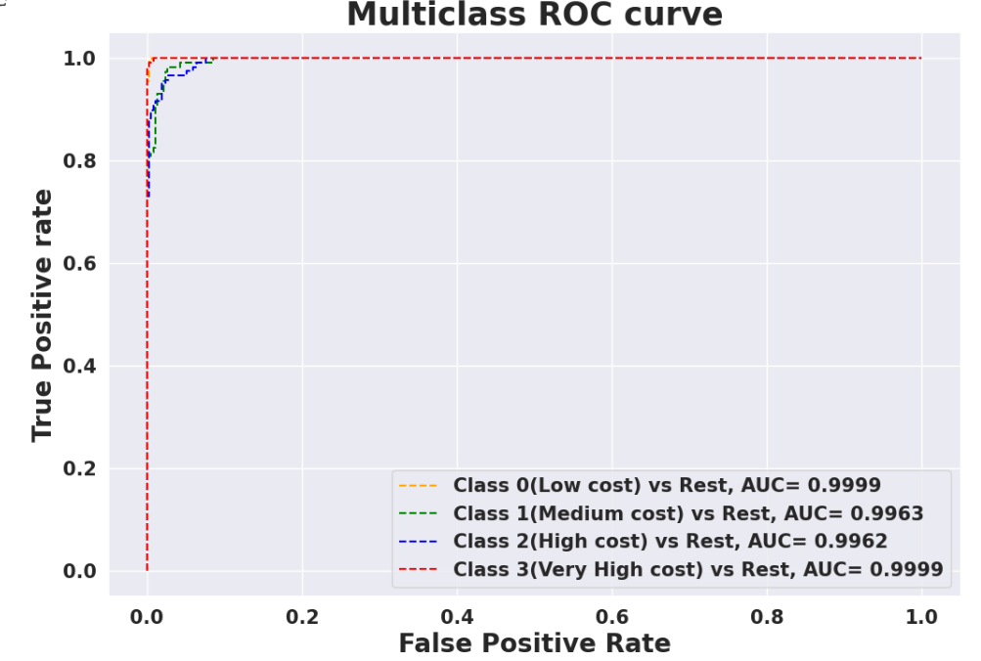
Model performance – ROC CURVE

Slide 18
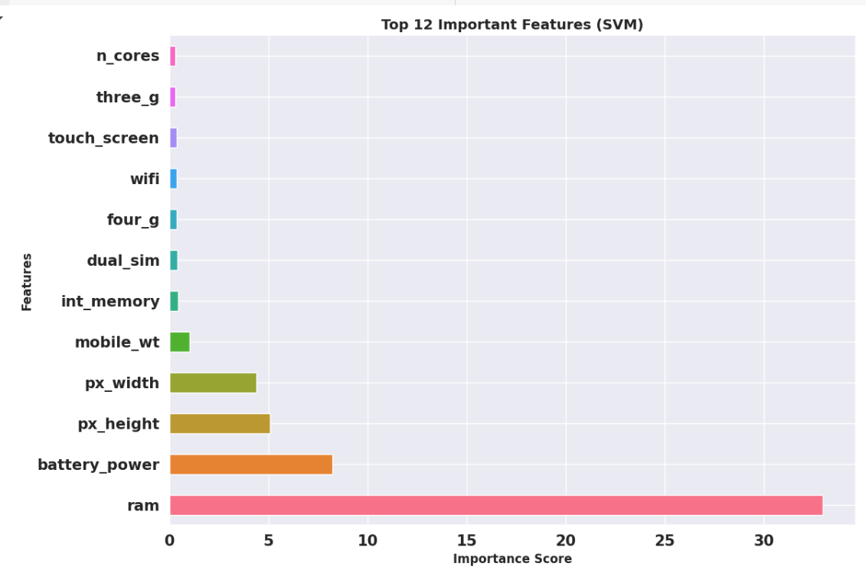
SVM – feature importance

Slide 19
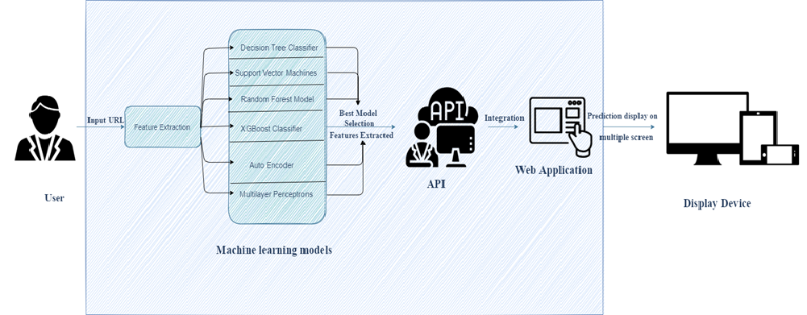
Architectural design of proposed system
The proposed system architecture for mobile pricing range detection is composed of several interconnected modules to ensure seamless operation from data input to result visualization.
It begins with data preprocessing, where inputs are transformed into meaningful features. These features feed into the machine learning models, with SVM selected for deployment due to its superior performance.

Slide 20
Design of web application
1. Web Application Development
Designed a user-friendly, browser-compatible web UI
Enabled input & prediction display
Built using HTML, CSS, JavaScript (or React)
2. Model Integration
Integrated final model into the backend (Flask/Django)
Connected model predictions to the frontend
Ensured real-time detection functionality
3. Deployment & Testing
Deployed web app to a live server
Tested for performance & user feedback
Ensured system stability and speed

Slide 21
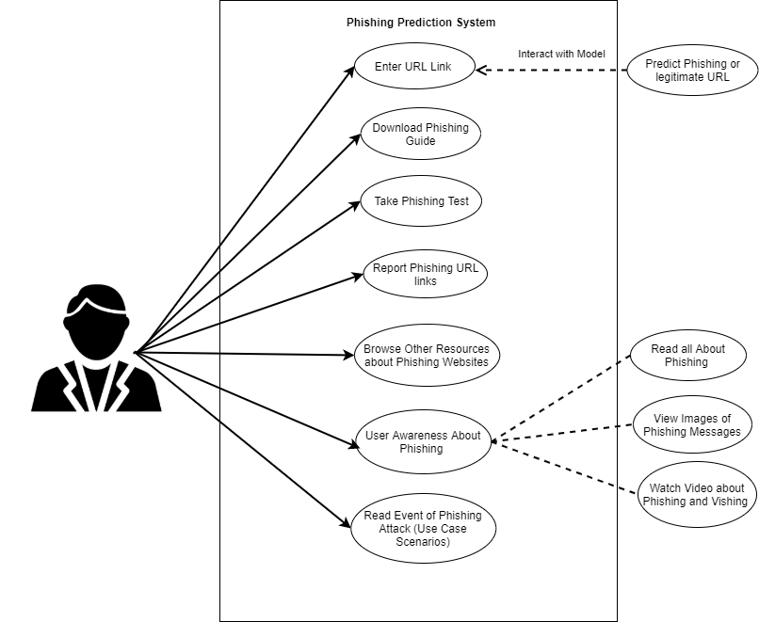
Use case of web application
The trained model is wrapped using a RESTful API, which acts as a communication layer between the backend model and the web application. The web application provides a user-friendly interface where users can input URLs and view the predictions in real time.
The final output is rendered on a display device, such as a desktop or mobile screen, enabling users to instantly determine whether a URL is phishing or legitimate.
Additionally, explainability features such as SHAP visualizations can be integrated into the web interface for transparency.
This modular architecture supports scalability, real-time detection, and easy integration into existing security systems.

Slide 22
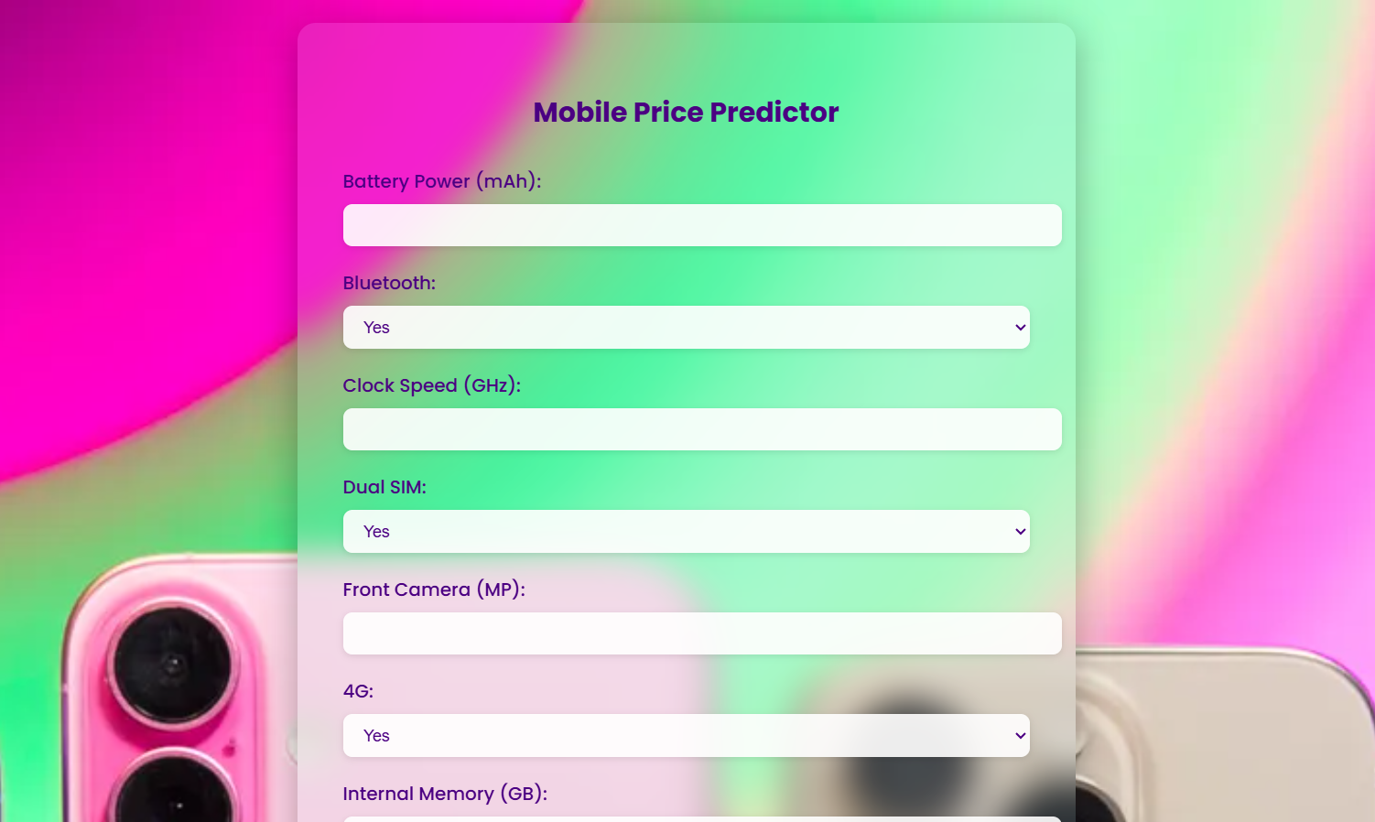
Front-End Web UI: mobile pricing range Detector

Slide 23
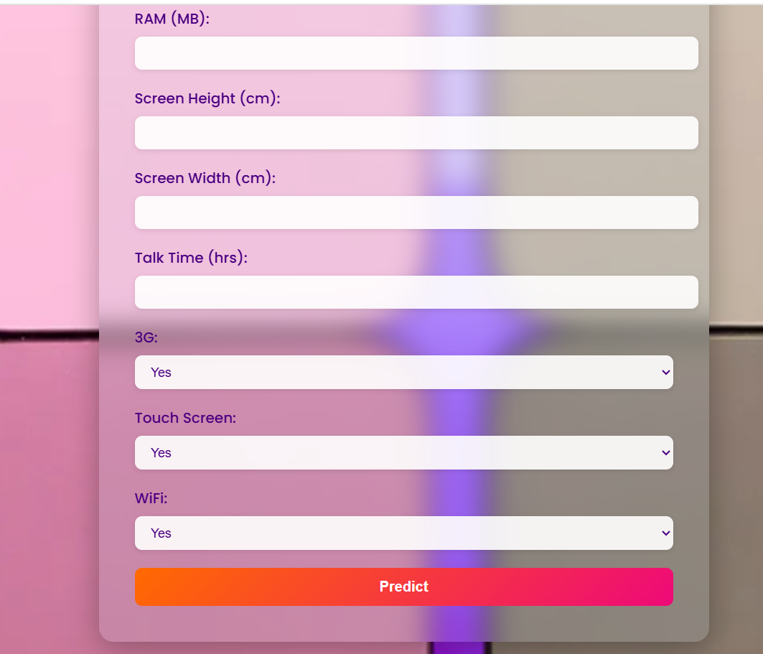
mobile pricing range Detector

Slide 24
THANK YOU

